Slide 1
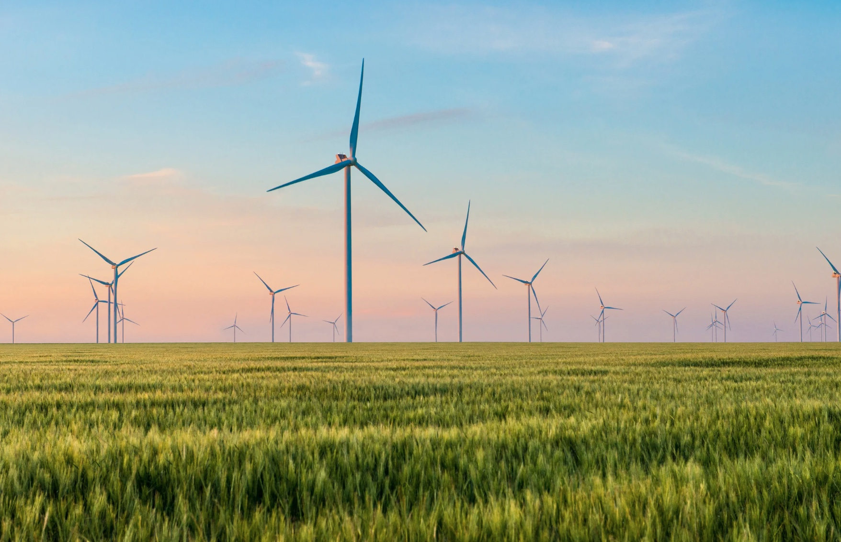
A Short Course on Robust Climate Policy
Module F: Global Mechanisms and Finance
Stephen Stretton
Climate Economics
American University, Kyiv
August 2024

Slide 2
Table of Contents
Course Outcomes
International Mechanisms and Finance
  Coordinating Policy
  Measuring Policy Effectiveness
  Enforcement of Commitments
  Creating Dynamic Incentives
  Trust-building

Slide 3
Three Key Outcomes
Introduction to Climate Economics: Explore climate economics through a fiscal lens, focusing on national and international efforts to achieve Paris Agreement targets.
Comprehensive Approach to Green Transition: Analyze the fiscal, financial, and energy security aspects of transitioning to a green economy, with a focus on perspectives relevant to middle-income countries like Ukraine.
Preparation for Professional Opportunities: Prepare participants for potential roles in the World Bank by developing skills for Short Term Consultancy (STC) opportunities.

Slide 4
Volz et al. (2021), ‘Debt Relief for a Green and Inclusive Recovery’.
Fankhauser at al. (2023), ‘Net Zero Portfolio Targets for Development Finance Institutions: Challenges and Solutions’
KPI Bonds Paper
CIT Paper

Slide 5
“The G20's Common Framework urgently needs to be revamped to include middle-income countries and allow for comprehensive debt relief by both public and private creditors oriented around a green, inclusive recovery… all low- and middle-income countries whose debt is considered unsustainable [should] participate in debt restructuring... Adequate incentives are needed to ensure that private creditors participate in debt restructuring where needed and bear a fair share of the burden. If… a country's sovereign debt is of significant concern, the IMF should make its programmes conditional on a restructuring process that includes private creditors on a comparable basis. ”
(Volz et al., 2023)

Slide 6
COORDINATING POLICY

Slide 7
Institutional Roles:
World Bank (WB): Covers approximately 2/3 of global emissions in principle.
International Monetary Fund (IMF): Broader scope, focusing on macroeconomic stability rather than directly on climate.
United Nations (UN): Facilitates global climate agreements, including emissions reduction pledges.
Other MDBs: Region-specific climate finance, infrastructure, and technical assistance.

Slide 8
Key Problems
Framing Problem: Economic Growth vs. Decarbonization
Unsustainable Debt: UNDP estimates that close to US$1.1 trillion is due in debt service payments by developing and emerging countries in 2021 alone.
Focus on Traditional Carbon Pricing: Greater focus is needed on alternative financing methods.
Notes:
Economic Growth vs. Decarbonization: Countries prioritize economic growth, historically linked to higher emissions without decarbonization policies.
Carbon Tax Pros:
Effective in principle due to national co-benefits.
GDP-neutral if revenue-neutral.
Carbon Tax Cons:
Unpopular and politically challenging.
Ineffective at realistic tax levels.
Not on the critical path to net zero—often not the first necessary step.
Limited motivation for small carbon taxes

Slide 9

Key Considerations
Local and Regional Coordination
Moving Beyond Traditional Carbon Pricing
Generalized Pricing Policy
Investment in Supply and Demand
Deforestation Commitments
Simplified Policy Mix
Effectiveness Measurement

Slide 10
REFORMING POLICY

Slide 11
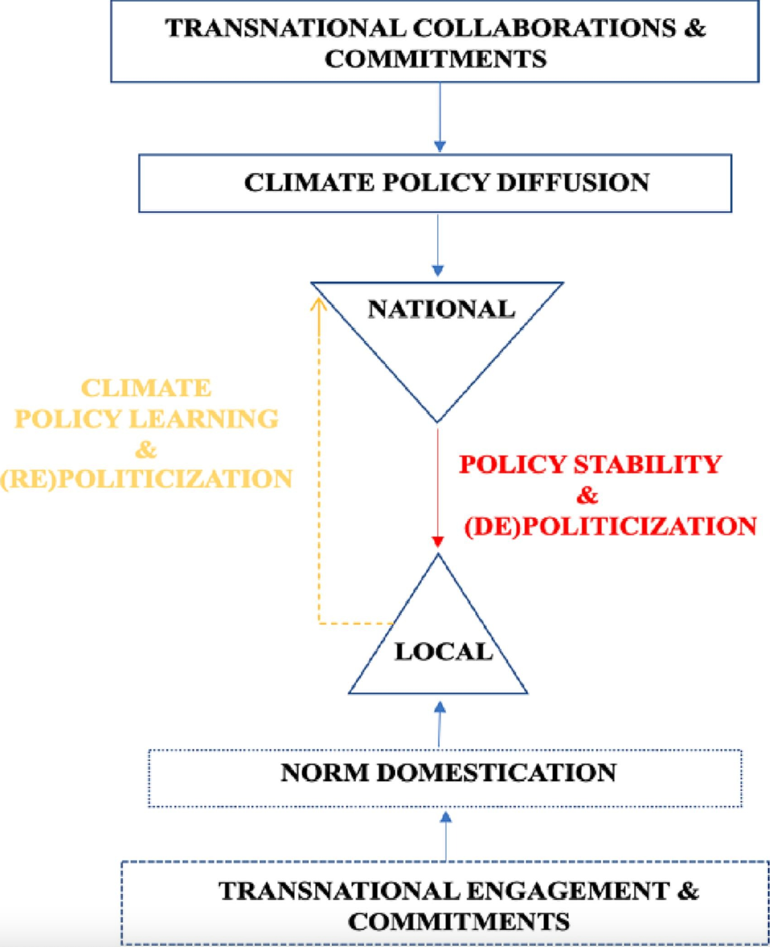
Key Metrics
Key Metrics:
Emission Reductions
Transformative Impact
Understanding Transformative Effects:
  Technology (Past): Past investments in renewable energy have significantly lowered costs as technology improved, leading to a transformed energy system.
  Norms (Future): Transformative Policies
Source: Yazar et al. (2023)

Slide 12
Three Key Needs
Enforcement of Commitments
Dynamic Incentives to Do The Right Thing
Trust Building Between Countries

Slide 13
Enforcement of Commitments
International Contracts
Increased Value: International contracts can enhance the value of national commitments by reducing investment risk, making projects more attractive to investors.
Liability: Ensures that countries remain accountable for their commitments, promoting transparency and responsibility in meeting climate goals.
Lower Interest Rates: International agreements can help countries secure lower interest rates, making it easier to finance large-scale renewable energy projects.
Notes:
By leveraging international contracts and trust funds, we can enhance accountability, reduce financial risk, and encourage stronger, more ambitious commitments.

Slide 14
Enforcement of Commitments
Trust Funds
Ensuring Fulfilment: Trust funds can provide a mechanism to ensure countries fulfil their obligations, offering financial security and reducing the risk of non-compliance.
Stronger Commitments: The presence of trust funds encourages countries to make bolder commitments, supported by the prospect of economic growth and access to favourable financing conditions.

Slide 15
Creating Dynamic Incentives
Why?
Motivation for Action
Example: Gym Membership
How?
Renewables Contracts
Small Countries as Norm Entrepreneurs
High-Return Processes
Notes:
Motivation for Action: Dynamic incentives create urgency and encourage early commitment, driving faster and more ambitious action.
. In a gym, people are encouraged to join quickly through time-limited incentives, fostering a sense of urgency and commitment.
Renewables Contracts: Offering better revenue deals for signing up early, such as with offshore wind contracts, creates a competitive dynamic and accelerates adoption.
Small Countries as Norm Entrepreneurs: Instead of asking countries to take small steps, incentivize small countries to take significant actions. Reward them for becoming leaders in setting global norms.
High-Return Processes: In equity investment, getting in early on a process with high returns is crucial. Similarly, can we design incentives to generate these high returns and encourage early participation?

Slide 16
Fulfilling Commitments on Time
Involvement of Development Partners
Regional Trials
Trade-Offs
Achieving Commitments
Trust-Building: A Two-Way Process

Slide 17
ROLE OF MDBs

Slide 18
Aligning Development Finance with Net Zero Goals (Fankhauser et al.)
Set context-specific emissions pathways with granular bottom-up data and emphasising climate-development win-wins
Deal with inertia and lumpiness in the portfolio through ‘when’ flexibility (multiyear carbon budgets) and ‘where’ flexibility (sharing of carbon space)
Encourage transition projects through future-emissions accounting and transition credits
Manage climate-development and other trade-offs with an internal carbon price and ESG standards
Account for emissions after project-end with monitoring and legal provisions

Slide 19
Debt Relief (Volz et al.)
Current Situation: Debt service is hindering crisis responses in many low- and middle-income countries. This threatens development prospects and climate adaptation efforts.
Systemic Challenge: The G20 Common Framework for Debt Treatments is inadequate for addressing the depth of the debt crisis.
IMF & World Bank Initiative: Build a scheme linking debt relief with Green, Resilient, and Inclusive Development (GRID). Focus on: Climate resilience and SDG-aligned investments; and Private creditor participation and comprehensive debt relief.
Global Collaboration: The G20, MDBs, and private creditors must align to support a green and inclusive recovery, ensuring fiscal space for climate resilience.

Slide 20
Two Proposals from Us!

Slide 21
KPI Bonds
  What?
    Align Private and Public Financing
    Incentivize Success
  How?
    Lower Costs for Sovereigns: Countries pay lower interest (coupon) if they meet specific climate-related KPIs.
    Fixed Returns for Investors: Investors receive a fixed return regardless of performance, making it a stable investment.
    Integration: Merge World Bank operations and private lending into one bond to improve efficiency and reduce market risks.
    Flexible Approach: Options like 'Prior Action' or Results-Based Climate Financing (RBCF) offer different levels of risk and reward.

Slide 22
Climate Incentives Trust
What?
  Promote Green Growth
  Provide Climate Insurance
How?
  Reduce Borrowing Costs: Improve creditworthiness and reduce borrowing costs for developing countries by absorbing risks.
  Early-Stage Investment: Focus on early-stage projects with blended finance to attract private investment and lower the cost of capital.
  Reward Climate Action: Use a dynamic incentive system to reward countries for proactive climate measures.

